Slide 1
Single Image Crowd Counting
Prepared by
1705055 MD Anwarul Karim
1705058 Fattah-Zul-Ikram

Slide 2
Problem Definition
Crowd counting from a single image
Can be done in two ways-
Input - Image, Output - Head count
Input - Image, Output - Density Map
Based on the paper: “Single-Image Crowd Counting via Multi-Column Convolutional Neural Network”

Slide 3
Dataset Analysis
ShanghaiTech Dataset
Total 1198 images
330,165 annotated heads
Divided into Part A and Part B
Part A - 482 images (300 for training)
Part B - 716 images (400 for training)

Slide 4
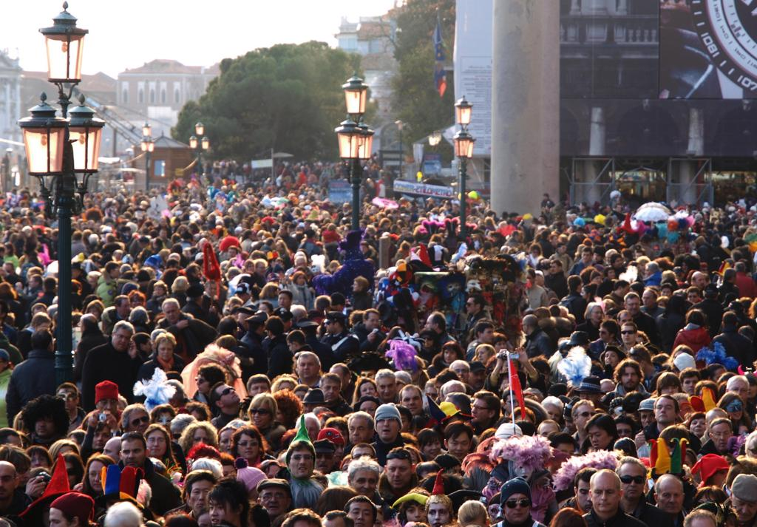
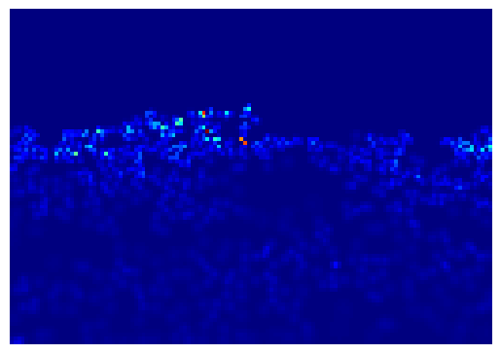
Dataset Analysis
Contains 3 sections
Image data
H5 file containing people density map
Matlab files contain annotated head

Slide 5
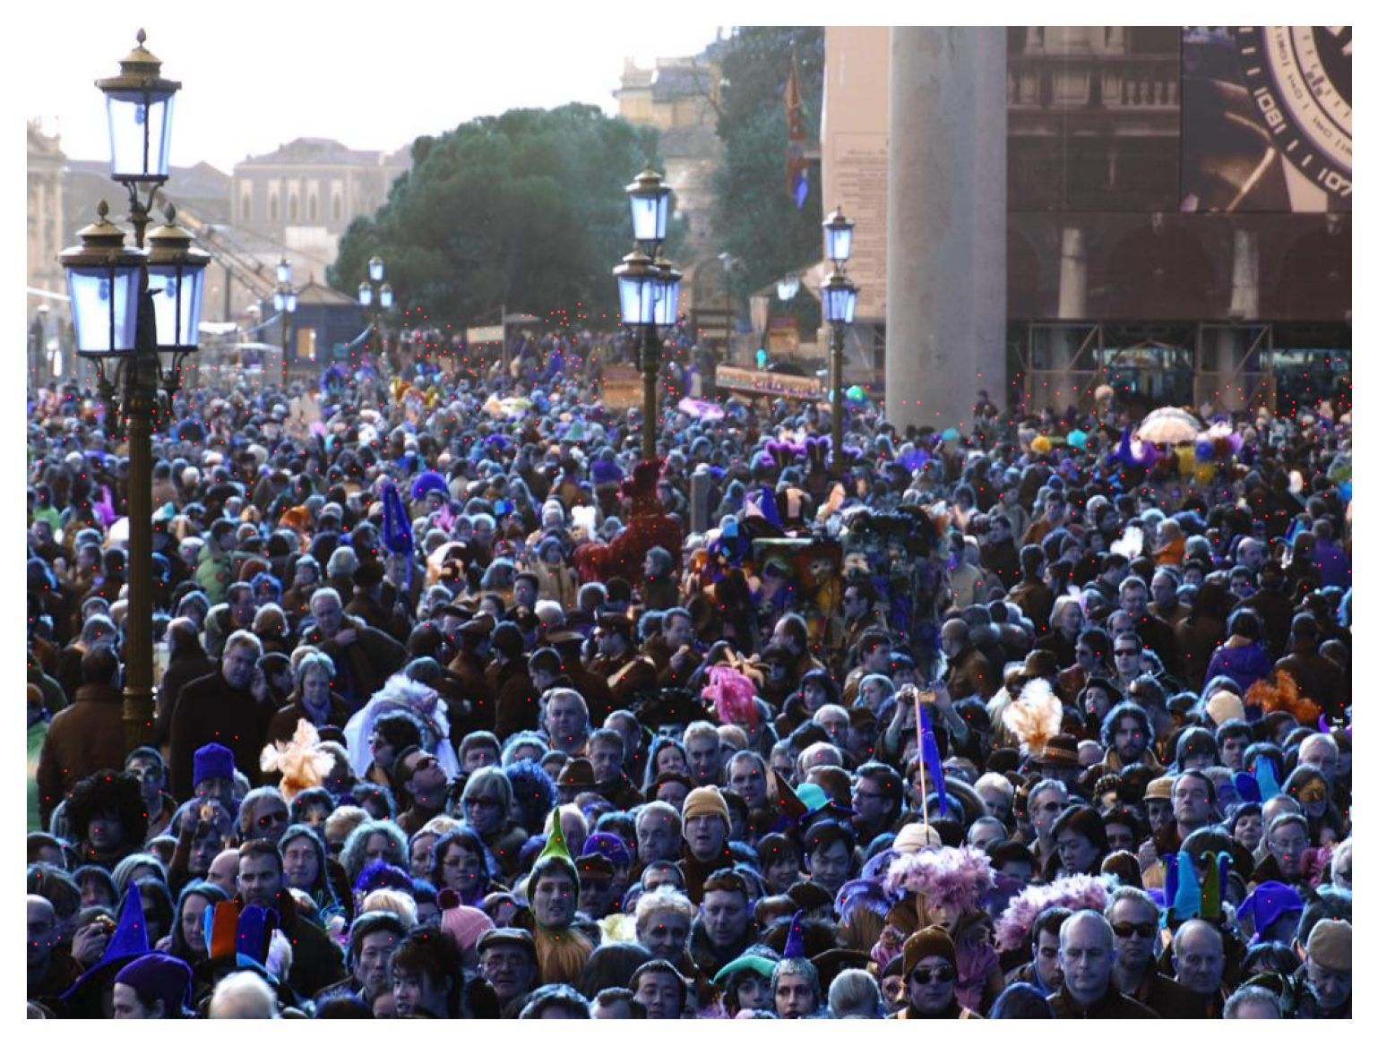
Annotated Head

Slide 6
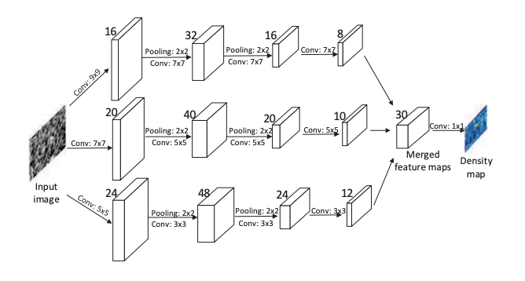
Architecture
Three columns
Different filter size
1*1 convolution layer instead of fully connected layer
2 Max Pool layers, 2*2

Slide 7
Architecture
MCNN (Multi-Column Convolutional Neural Network)
Total params: 127,953
Trainable params: 127,953
Non-trainable params: 0

Slide 8
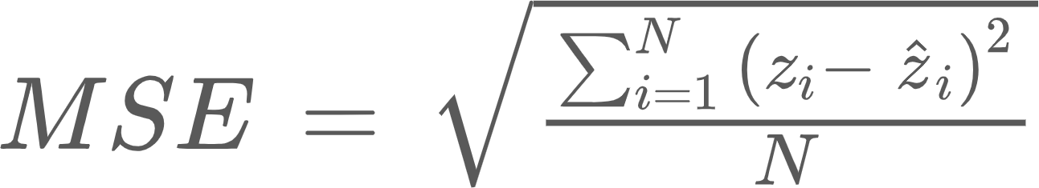
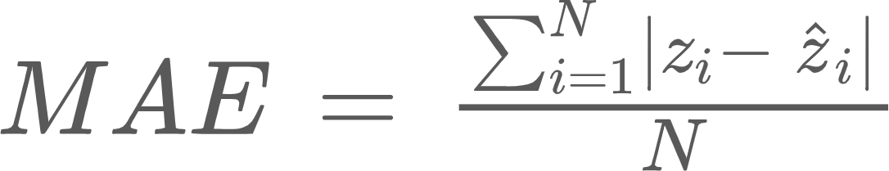
Loss
MSE(Mean Squared Error)
MAE (Mean Absolute Error)

Slide 9
Performance Report
Experimentation variables:
Epochs : 500
Learning Rate : 0.00001
Momentum = 0.9
Optimizer = SGD

Slide 10
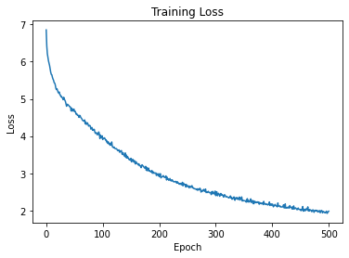
Training for Part A dataset

Slide 11
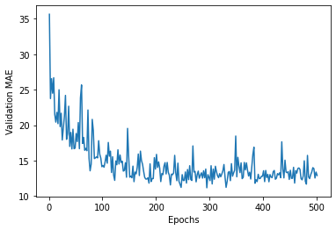
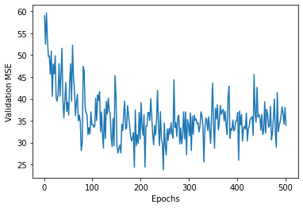
Validation for Part A dataset
Validation MAE Validation MSE

Slide 12
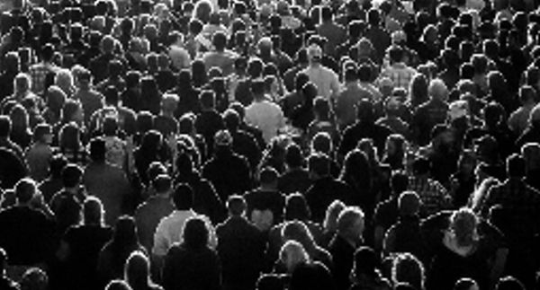
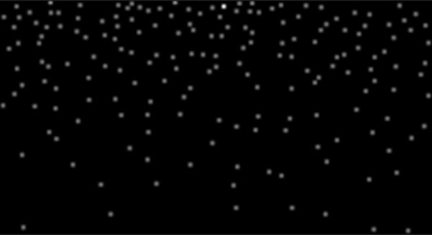
Visualize a result
Image Ground Truth

Slide 13
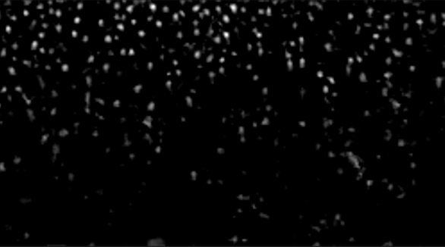
Visualize a result
Output

Slide 14
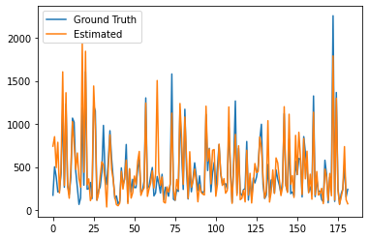
Ground truth vs Estimated (Part A Dataset)
Head Count
Images

Slide 15
Testing and Comparing Part A
Method | MAE | MSE
LBP+RR | 303.2 | 371.0
Deep CNN | 181.8 | 277.7
MCNN-CCR | 245.0 | 336.1
MCNN (Our) | 116.4 | 184.9
MCNN (Paper) | 110.2 | 173.2

Slide 16
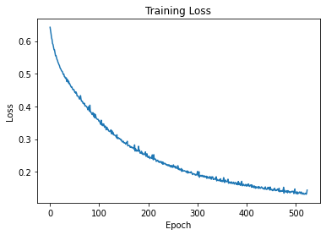
Training for Part B dataset

Slide 17
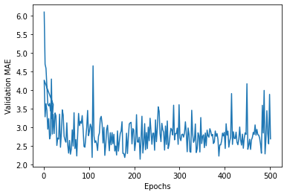
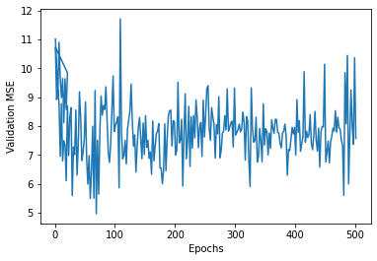
Validation for Part B dataset
Validation MAE Validation MSE

Slide 18
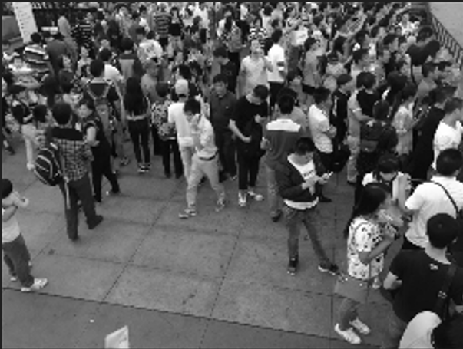

Visualize a sample result
Image Ground Truth

Slide 19

Visualize a sample result
Output

Slide 20
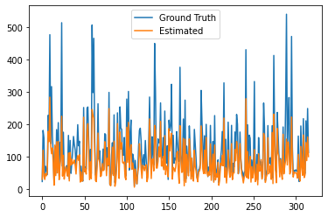
Ground truth vs Estimated (Part B Dataset)
Head Count
Images

Slide 21
Testing and Comparing Part B
Method | MAE | MSE
LBP+RR | 59.1 | 81.7
Deep CNN | 32.0 | 49.8
MCNN-CCR | 70.9 | 95.9
MCNN (Our) | 40.9 | 64.3
MCNN (Paper) | 26.4 | 41.3

Slide 22
Testing UCC 50 Dataset
Test MAE without fine tuning: 502.7
Test MSE without fine tuning: 737.6
Transfer learning setup - freeze all layers except the last layer
Total params: 127,953
Trainable params: 31
Non-Trainable params: 127,922

Slide 23
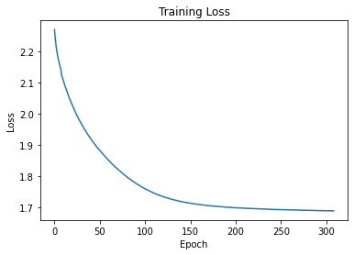
Fine tuning last layer for UCC_50 dataset

Slide 24
Testing UCC_50 dataset
Method | MAE | MSE
Rodriguez et al. | 655.7 | 697.8
Lempitsky et al. | 493.4 | 487.1
Idrees et al. | 419.5 | 541.6
MCNN (Our) | 457.2 | 575.3
MCNN (Paper) | 377.6 | 509.1

Slide 25
Challenges & Discussions
Number of data
Mitigated with data augmentation - split each image into 9 images
Working with .mat data
Resource issues

Slide 26
Thank You

